Slide 1
CRM-Based Customer Churn Prediction Using Machine Learning
A Customer 360 Analytics Approach
MBA Final Project – Business Analytics
Marisha Gavkar • Golden Gate
University • Machine Learning Predictive Analytics• 12/19/2025
Notes:
This presentation outlines a CRM-based approach to customer churn prediction using machine learning, structured as an MBA final project.

Slide 2
Business Background
Subscription-based businesses depend heavily oncustomer retention.
Acquiring new customers is5-7x more expensivethan retention.
High churn leads to:
Companies useCRM systemsto track behavior but oftenreact too late.
Notes:
Subscription businesses rely on retention. Acquisition is costly (5-7x). Churn hurts revenue and LTV. Current CRM usage is often reactive.

Slide 3
Problem Statement
Business Problem
• How can organizationspredict customer churnin advance?
• How can predictions beintegrated into CRM systemsfor action?
Analytics Challenge
• Raw CRM data is fragmented.
• Traditional reports detect churnafter it happens.
• Need apredictive + interpretablesolution.
Notes:
The core problem is predicting churn proactively and integrating it into CRM. Challenges include fragmented data and the need for interpretability.

Slide 4
Project Objectives
Transform raw customer data intoCRM-style entities.
Build a unifiedCustomer 360 view.
Develop amachine learning churn prediction model.
Identifykey drivers of churn.
Translate insights intoactionable CRM strategies.
Notes:
Our goals are to create CRM entities, build a Customer 360 view, develop a prediction model, identify churn drivers, and formulate strategies.

Slide 5
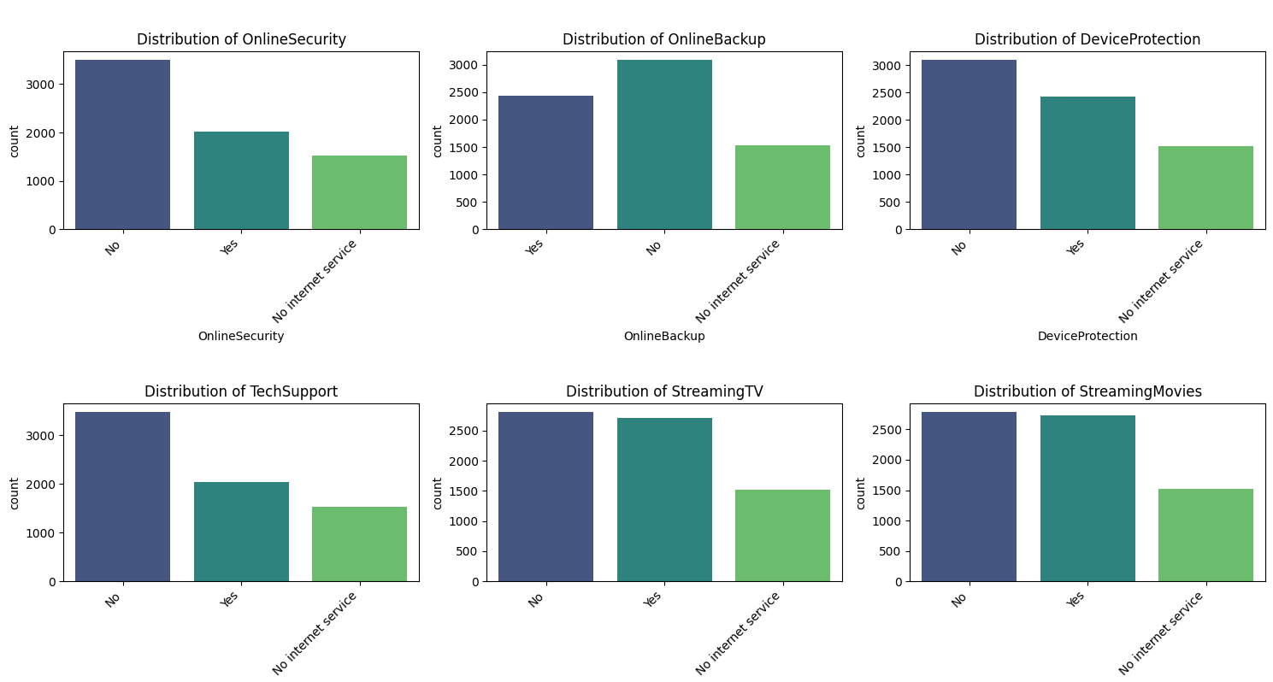
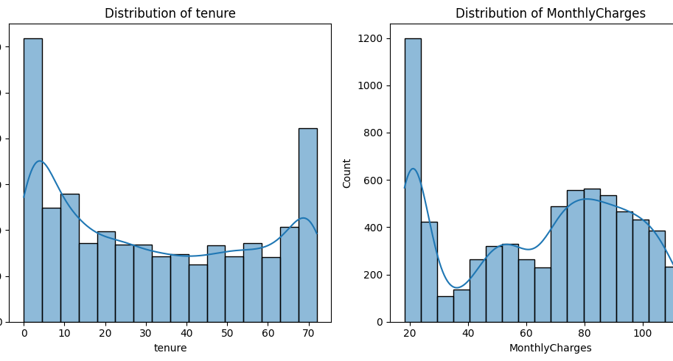
Dataset Overview
Dataset:Telco Customer Churn (IBM) with 7,000+ customer records.
Includes: Tenure, Billing, Subscription details, Service usage, Payment info.
Target:Churn (Yes/No). Closely resembles a subscription CRM system.
Categorical feature distributions
Tenure and MonthlyCharges distributions
Notes:
We use the Telco Churn dataset, covering tenure, billing, and services. Visuals show categorical and numeric feature distributions.

Slide 6
Why CRM-Based Modeling?
Traditional Approach
• One flat dataset
• Direct modeling
• Limited business interpretability
This Project’s Approach
• CRM-styleentity modeling
• Separation of operational & analytics layers
• Mirrors Dynamics 365 / MS Fabric architecture
• Makes the modelbusiness-ready
Notes:
Traditional modeling uses flat datasets. Our CRM-based approach separates operational and analytics layers, mimicking enterprise architectures for better interpretability.

Slide 7
CRM Entity Modeling
Account Entity:Customer tenure, Lifetime value
Subscription Entity:Contract type, Monthly charges, Billing preferences
Usage / Feature Adoption Entity:Enabled services, Feature breadth
Support Entity:Technical support availability
Churn Label Entity:Renewal outcome
Notes:
We decomposed raw data into Account, Subscription, Usage, Support, and Churn Label entities to mirror CRM structures.

Slide 8
Customer 360 View
All CRM entities joined ataccount level.
Created a unifiedCustomer 360 dataset.
Represents analytics layer used in tools likeMicrosoft FabricandCustomer Insights.
Clean separation between:
This dataset is thefoundation for modeling.
Notes:
The Customer 360 view unifies all entities at the account level, serving as a clean analytics layer for modeling.

Slide 9
Feature Engineering
Business logic applied to create meaningful features:
Contract risk indicators
Feature adoption counts
Support risk flags
Pricing signals
Key Idea: Business understanding → model-ready features
Notes:
We engineered features based on business logic like contract risk and adoption counts. Business understanding drives model-ready features.

Slide 10
Modeling Approach
Model Used:Logistic Regression
Why Logistic Regression?
Steps:
Model Evaluation Metrics
Model performance evaluated using:
Focus: High recall for churn → fewer at-risk customers missed
Notes:
We chose Logistic Regression for its interpretability and suitability for binary outcomes. Steps included encoding, scaling, and evaluation.

Slide 11
Key Drivers of Churn
Contract Type:Month-to-month customers churn more
Customer Tenure:New customers are higher risk
Monthly Charges:Higher charges increase churn probability
Service Adoption:Fewer services → higher churn
Technical Support:Lack of support increases churn risk
Notes:
Key churn drivers include month-to-month contracts, low tenure, high charges, low service adoption, and lack of technical support.

Slide 12
Business Insights
Long-term contracts reduce churn.
Early customer lifecycle is critical.
Bundled services increase retention.
Support availability improves customer loyalty.
These insights align withCRM and customer behavior theory.
Notes:
Insights confirm that long-term contracts, bundling, and support improve retention, aligning with established CRM theories.

Slide 13
Managerial Recommendations
CRM Actions:
Target month-to-month customers with contract upgrades
Strengthen onboarding for new customers
Promote service bundles to increase adoption
Proactive technical support for high-risk customers
Outcome:Shift fromreactivetopredictiveCRM strategy
Notes:
Recommendations focus on proactive CRM actions like contract upgrades and better onboarding, shifting strategy from reactive to predictive.

Slide 14
Business Value
Reduced churn and higher customer lifetime value
Better targeting of retention campaigns
Data-driven CRM decision-making
Scalable framework for other subscription industries
Notes:
The project delivers value through reduced churn, better targeting, data-driven decisions, and a scalable framework.

Slide 15
Limitations
Dataset from a single industry
Only baseline ML model used
No real-time or behavioral data
External factors not included
Notes:
Limitations include single-industry data, baseline models only, lack of real-time data, and exclusion of external factors.

Slide 16
Future Enhancements
Advanced models (Random Forest, XGBoost)
Real-time churn scoring via APIs
Integration with CRM dashboards
Expansion to other industries (SaaS, Banking)
Notes:
Future steps involve advanced models, real-time scoring, CRM integration, and cross-industry expansion.

Slide 17
Conclusion
Built anindustry-aligned CRM analytics pipeline
Created aCustomer 360 view
Applied interpretable machine learning
Deliveredactionable business insights
Demonstrates how Business Analytics + CRM + ML work together
Notes:
We successfully built a CRM pipeline, Customer 360 view, and ML models to deliver actionable insights, demonstrating the synergy of analytics, CRM, and ML.

Slide 18
Thank You
Notes:
Thank you for your attention. I am now happy to answer any questions you may have about the data or the analysis.

